Slide 1
CSR to Member Email
Workflow
WebCast for all CSRs

Slide 2
Objectives
Grid Review
Approval Emails
Notes:
In this eCast you will become familiar with the various features used for the Approval Emails process through Next Gen. The information presented is part of the workflow for getting a claims adjustment completed. You will learn about:
Grid Review and
Approval Emails

Slide 3
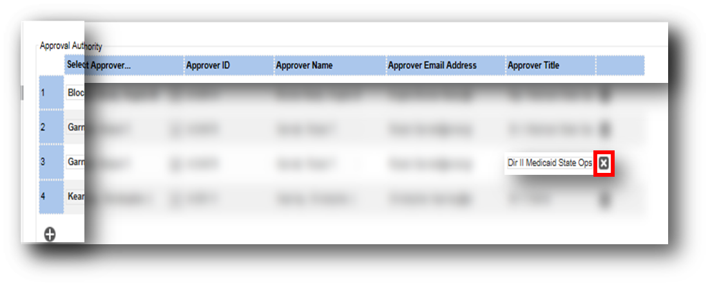
Grid Review: Removing Approvers
To remove an approver: Click the next to his/her title.
Click to remove the person
Notes:
If an approver needs to be removed from the grid, click the X in the gray box next to that approver’s title.

Slide 4
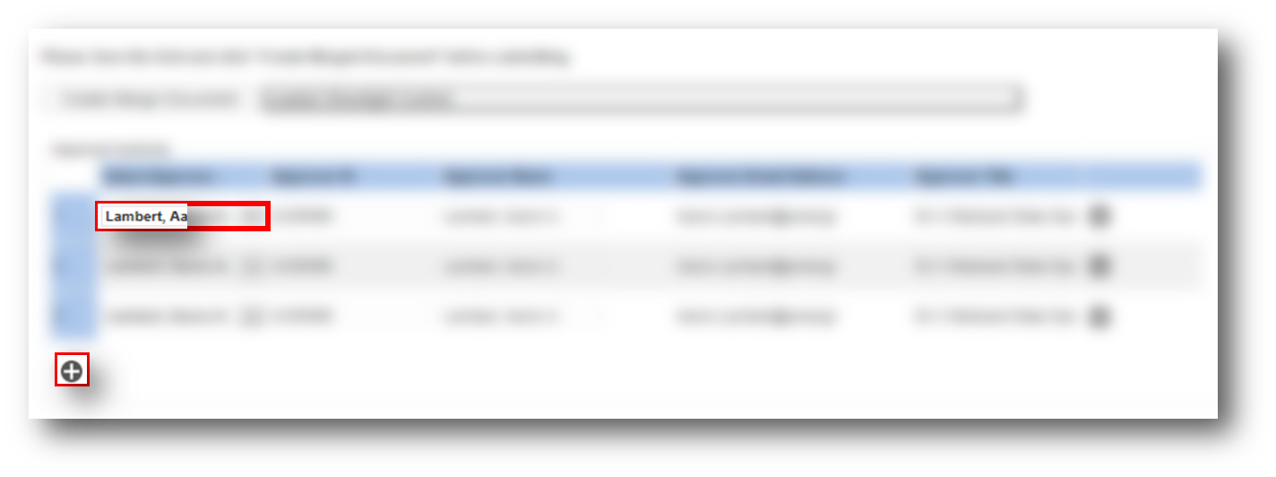
Grid Review – Adding Approvers
Step 1: Click the button to add an approver.
Step 2: Select a name from the drop down list of names.
Step 3: Select other to add anyone within our company.
Notes:
To add an approver, simply click the + button below the grid. Next, choose the name from the drop down list of approver names already loaded to Next Gen as approvers for any market. There is also an option marked other, that will allow anyone within Anthem to be added.

Slide 5
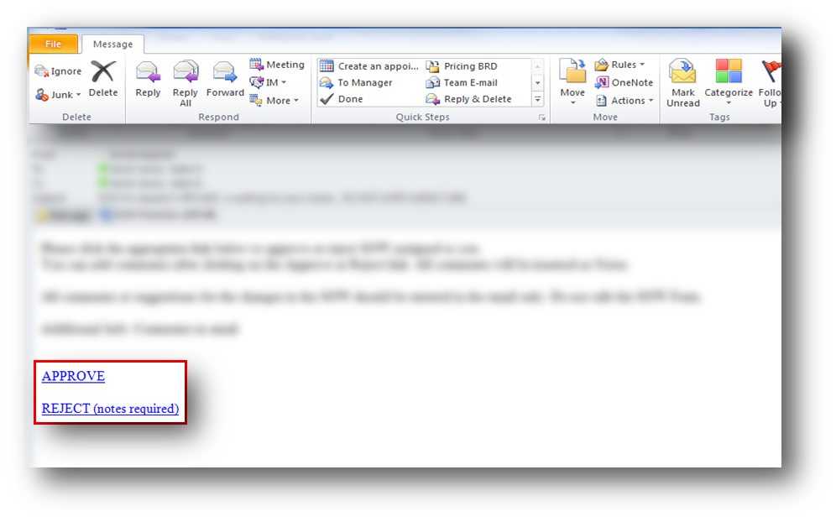
Approval Emails: Steps 1 – 2
Step 1: Review the email and attached documents.
Step 2: Click APPROVE or REJECT (notes required).
Notes:
The approval emails are a sequential process. Once an approver has completed their portion of an approval, it will move to the next approver and will continue until to the next person in line until completion. Before responding to the email, review the message as well as any attached documents in its entirety. Once the information has been reviewed, choose APPROVE or REJECT.

Slide 6
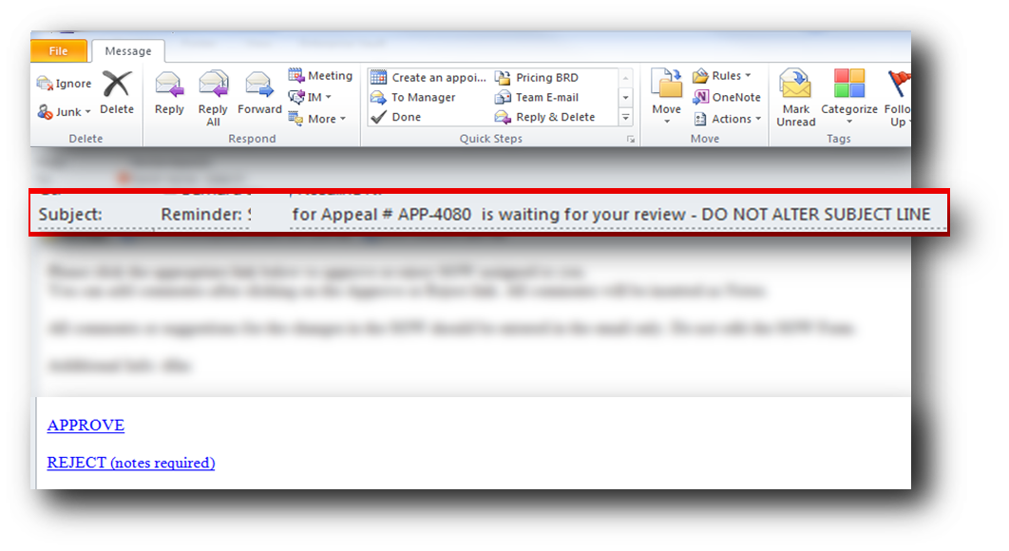
Approval Emails: Steps 3 – 4
Step 3: Add any comments you want the creator to review.
Step 4: Attach any additional documents.
Step 5: Click Send on the email.
Note: If you do not respond, a reminder email will be sent three hours before Service Level agreement expiration
Notes:
After the link has been chosen to approve or reject, a new email will open. Add any comments can for the creator of the SOW if necessary, then click Send. Any emails that are not responded to will force a reminder email three hours prior to the Service Level agreement.

Slide 7
Summary
In this WebCast you learned about:
Grid Review
Approval Emails
Notes:
In this eCast you learned how to:
How to review the grid before sending for approval
The steps to send Approval Emails
This concludes the Statement of Work (SOW) Approval Emails eCast.
You may now close this window to mark completion of the eCast.

